Slide 1
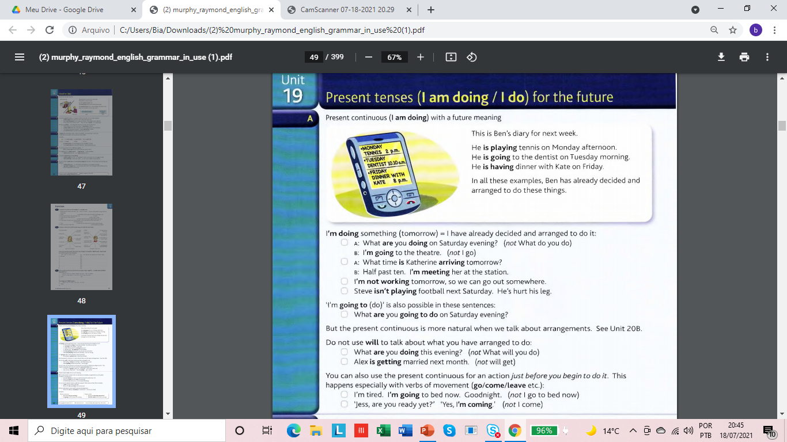

Slide 2
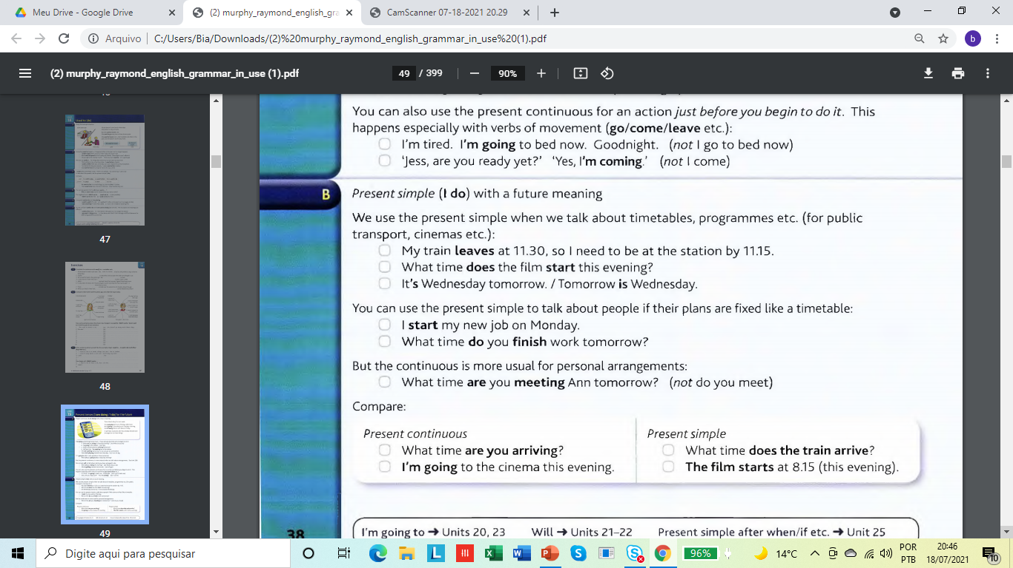

Slide 3
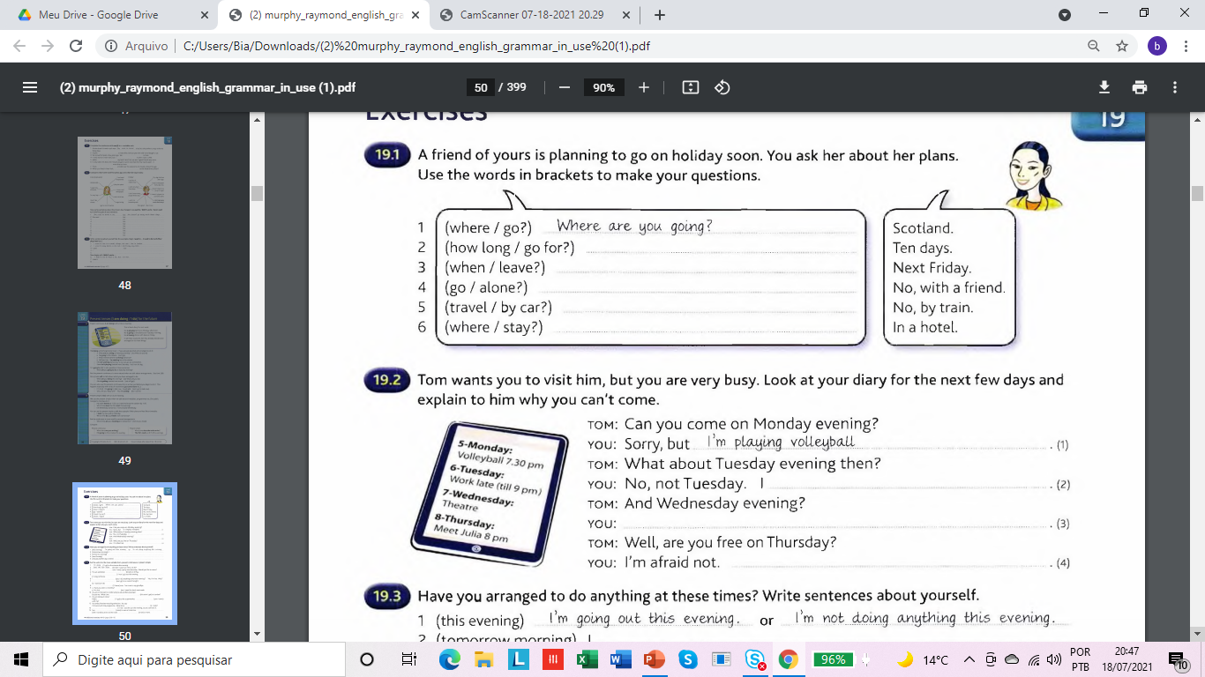

Slide 4
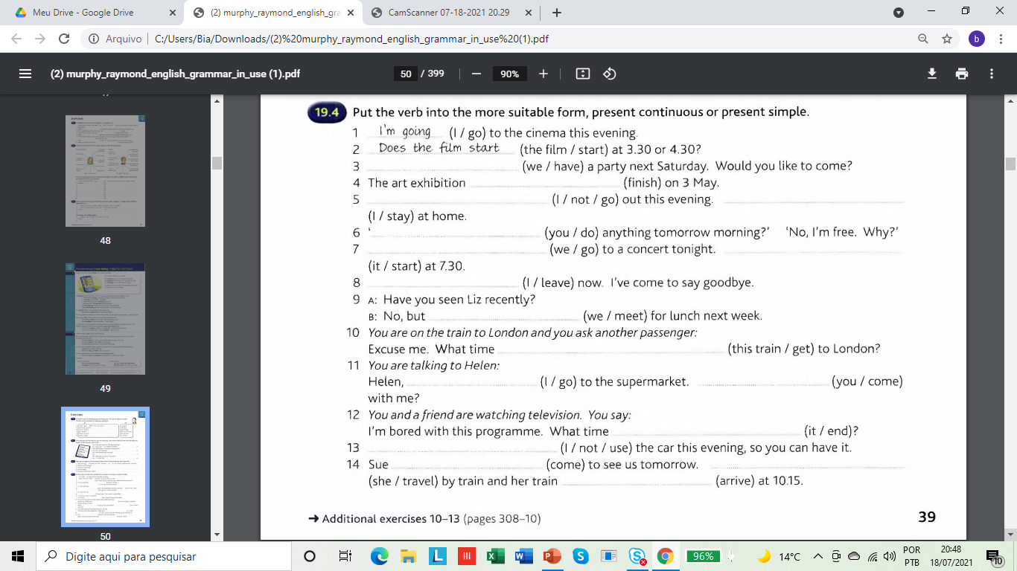

Slide 5
References :
Murphy, R. English Grammar in Use. Fourth Ed./2012

